Slide 1
Conducting Behavioral Research on Amazon’s Mechanical Turk
Winter Mason
Siddharth Suri
Yahoo! Research, New York
Notes:
Start: 5:45 end: 6:08

Slide 2
Outline
Why Mechanical Turk?
Mechanical Turk Basics
Internal HITs
  Labeling data
  Surveys
External HITs
  Random Assignment
  Synchronous Experiments
Conclusion

Slide 3
What is Mechanical Turk?
Crowdsourcing
  Job(s) outsourced to a group through an open call (Howe ‘06)
Online Labor Market
  Place for requesters to post jobs and workers to do them for pay
This Talk
  How can we use Mturk for behavioral research?
  What kinds of behavioral research can we use Mturk for?
Notes:
Small screen shot?

Slide 4
Why Mechanical Turk?
Subject pool size
  Central place for > 100,000 workers (Pontin ‘07)
Subject pool diversity
  Open to anyone globally with a computer, internet connection
Low cost
  Reservation Wage: $1.38/hour (Chilton et al ‘10)
  Effective Wage: $4.80/hour (Ipeirotis, ’10)
Faster theory/experiment cycle
  Less coordination then getting subjects in a lab
  Always-available subject pool
Notes:
Open to anyone globally? Paid in dollars or rupees?
Picture of cycle?

Slide 5
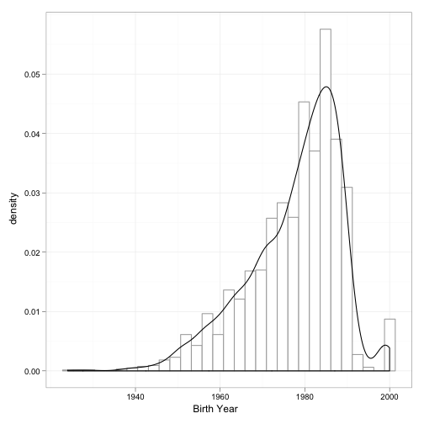
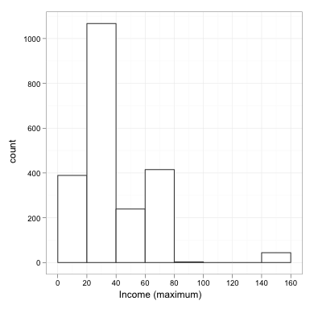
Worker Demographics
Self reported demographic information from 2,896 workers over 3 years (MW ‘09, MW ‘11, SW ’10)
55% Female, 45% Male
  Similar to other internet panels (e.g. Goldstein)
Age:
  Mean: 30 yrs,
  Median: 32 yrs
Mean Income: $30,000 / yr
Similar to Ipeirotis ‘10, Ross et al ’10

Slide 6
Internal Consistency of Demographics
207 out of 2,896 workers did 2 of our studies
  Only 1 inconsistency on gender, age, income (0.4%)
31 workers did ≥ 3 of our studies
  3 changed gender
  1 changed age (by 6 years)
  7 changed income bracket
Strong internal consistency

Slide 7
Why Do Work on Mechanical Turk?
“Mturk money is always necessary to make ends meet.”
  5% U.S. 13% India
“Mturk money is irrelevant.”
  12% U.S. 10% India
“Mturk is a fruitful way to spend free time and get some cash.”
  69% U.S. 59% India
(Ross et al ’10, Ipeirotis ’10)

Slide 8
Requesters
Companies crowdsourcing part of their business
  Search companies: relevance
  Online stores: similar products from different stores (identifying competition)
  Online directories: accuracy, freshness of listings
  Researchers
Intermediaries
  CrowdFlower (formerly Delores Labs)
  Smartsheet.com
Notes:
Main point of this slide is: who are your competitors

Slide 9
Turker Community
Asymmetry in reputation mechanism
Reputation of Workers is given by approval rating
  Requesters can reject work
  Requesters can refuse workers with low approval rates
Reputation of Requesters is not built in to Mturk
  Turkopticon: Workers rate requesters
  Turker Nation: Online forum for workers

Slide 10
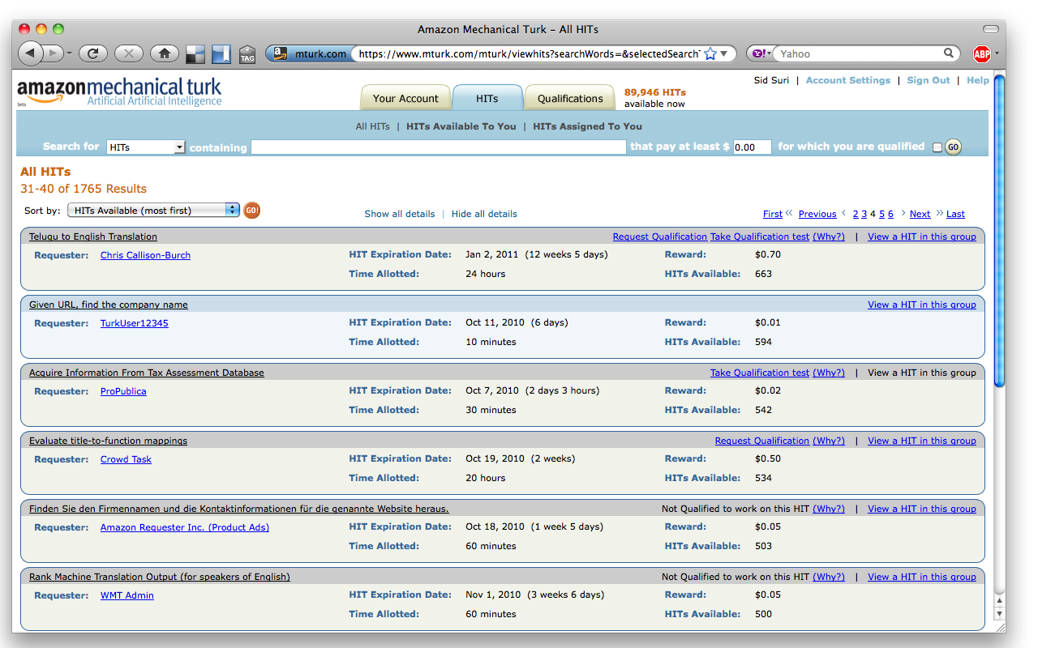
Anatomy of a HIT
HITs with the same title, description, pay rate, etc. are the same HIT type
HITs are broken up into Assignments
A worker cannot do more than 1 assignment of a HIT
Notes:
Picture here

Slide 11
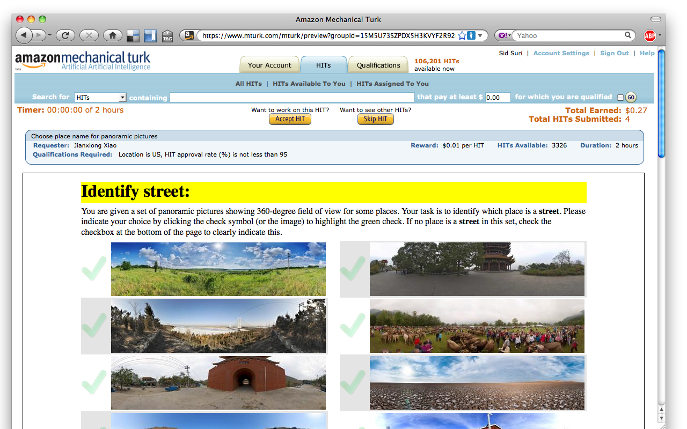
Anatomy of a HIT
HITs with the same title, description, pay rate, etc. are the same HIT type
HITs are broken up into Assignments
A worker cannot do more than 1 assignment of a HIT
Notes:
Picture here

Slide 12
Anatomy of a HIT
Multiple HITs are grouped by HIT type
HITs with the same title, description, pay rate, etc. are the same HIT type
HITs are broken up into Assignments
A worker can only do at most 1 assignment of a HIT
Notes:
Picture here

Slide 13
Lifecycle of a HIT
Requester builds a HIT
  Internal HITs are hosted by Amazon
  External HITs are hosted by the requester
  HITs can be tested on {requester, worker}sandbox.mturk.com
Requester posts HIT on mturk.com
  Can post as many HITs as account can cover
Workers do HIT and submit work
Requester approves/rejects work
  Payment is rendered
  Amazon charges requesters 10%
HIT completes when it expires or all assignments are completed

Slide 14
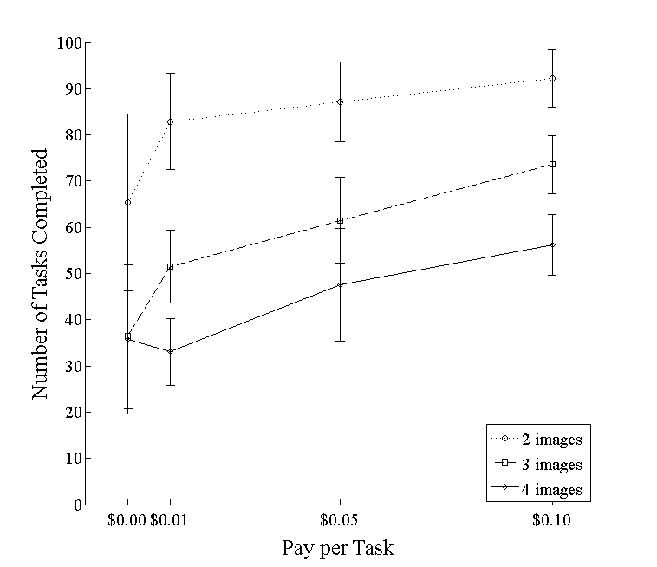
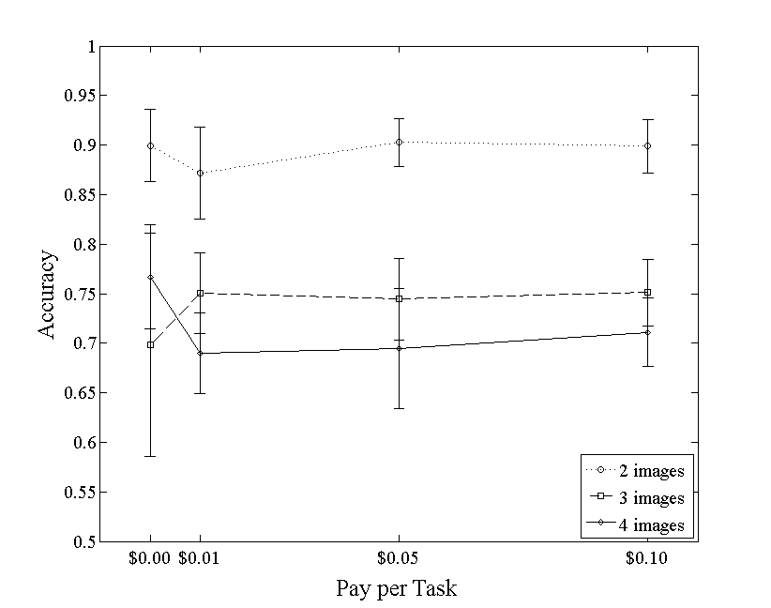
How Much to Pay?
Pay rate can affect quantity of work
Pay rate does not have a big impact on quality
(MW ’09)

Slide 15
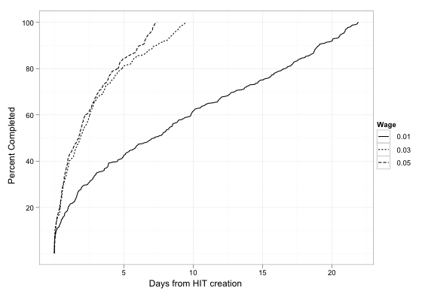
Completion Time
3, 6-question multiple choice surveys
Launched same time of day, day of week
$0.01, $0.03, $0.05
Past a threshold, pay rate does not increase speed
Start with low pay rate work up

Slide 16
Surveys on AMT
Template tool
Variables
External Survey Tools
Privacy Survey
Use cases

Slide 17
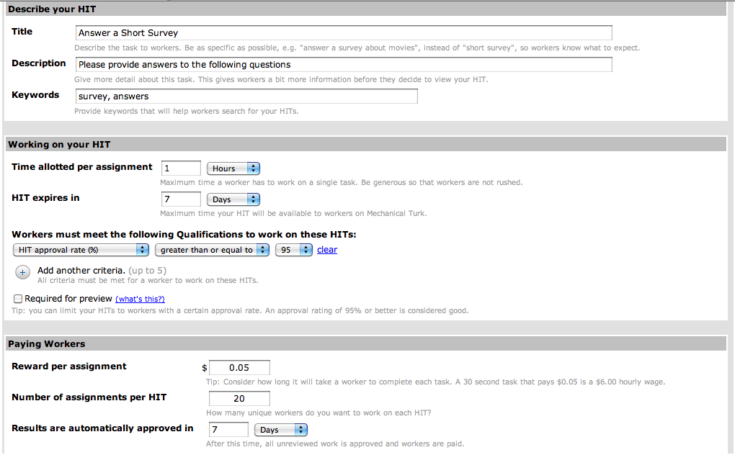
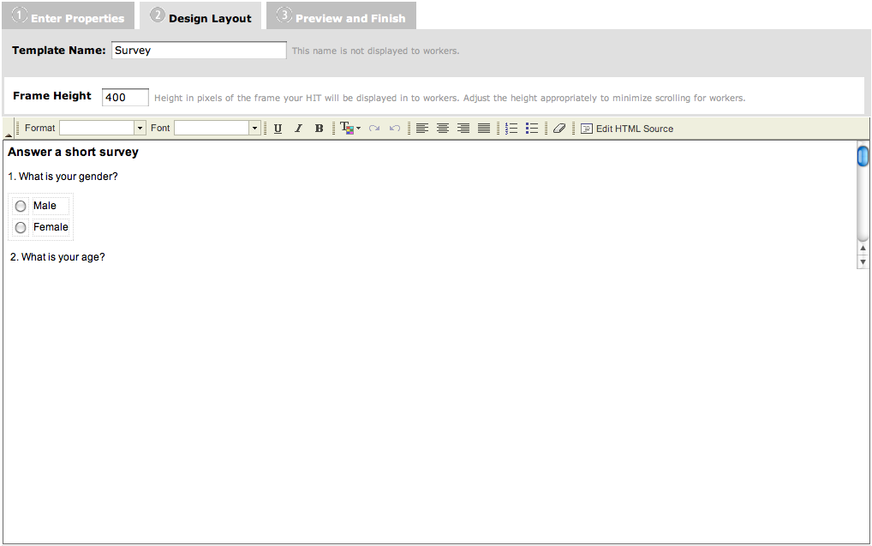
AMT Templates
Hosted by Amazon
Set parameters for HIT
  Title
  Description
  Keywords
  Reward
  Assignments per HIT
  Qualifications
  Time per assignment
  HIT expiration
  Auto-approve time
Design an HTML form

Slide 18
Variables in Templates
 | ${img} | ${URL}
HIT 1 | img1.jpg | url1
HIT 2 | img2.jpg | url2
HIT 3 | Img3.jpg | url3
HIT 4 | Img1.jpg | url2
HIT 5 | Img2.jpg | url3
HIT 6 | Img3.jpg | url1
HIT 7 | Img1.jpg | url3
HIT 8 | Img2.jpg | url1
HIT 9 | Img3.jpg | url2
Is this image:
<img src=${img}>
In this URL?
<a href=${URL}> ${URL} </a>

Slide 19
External Survey Tools
 | ${token}
HIT 1 | AF3dh
HIT 2 | 4SoUtb
HIT 3 | y8Ewfc
HIT 4 | Qwenj
HIT 5 | saH7w
HIT 6 | JWn23
HIT 7 | aObv5
HIT 8 | dTccR
HIT 9 | G9d31
Click this link to go to the survey:
<a href=“http://surveymonkey.com/mysurvey&id=${token}”>
http://surveymonkey.com/mysurvey
</a>
Enter this token in the first question: ${token}
You will only be paid for completing one survey
Notes:
Or use javascript instead of variables to create random token
This technique will work for any online experiment

Slide 20
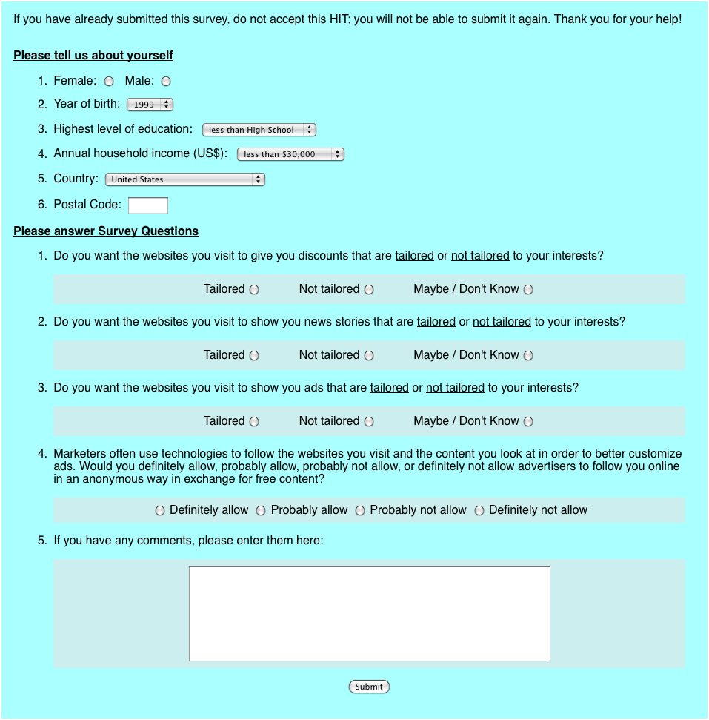
Privacy survey
External HIT
  Random order of answers
  Random order of questions
  Pop-out questions based on answers
Changed wording on question from Annenberg study:
Do you want the websites you visit to show you ads that are {tailored, relevant} to your interests?

Slide 21
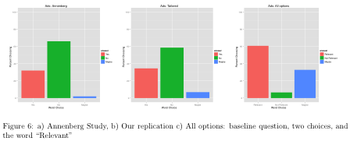
Results
Replicated original study
Found effect of differences in wording

Slide 22
Results
BUT
Not representative sample
Results not replicated in subsequent phone survey
Replicated original study
Found effect of differences in wording

Slide 23
Use Cases for Surveys
Pilot survey
Iterative design process with feedback from potential users
“Polling” for wisdom of crowds / general knowledge
Notes:
Last bullet point probably belongs elsewhere

Slide 24
Random Assignment
One HIT, multiple Assignments
  Only post once, or delete repeat submissions
Javascript on Internal HIT
External HIT
  Record mapping between Worker ID, Assignment ID, and condition
  Check status on “accept HIT”
  Preview page
Intent-to-treat

Slide 25
External HIT
Preview page neutral for all conditions
Once HIT accepted:
  If new, record WorkerID, assign to condition
  If old, get condition, “push” worker to last seen state of study
Wage conditions = pay through bonus

Slide 26
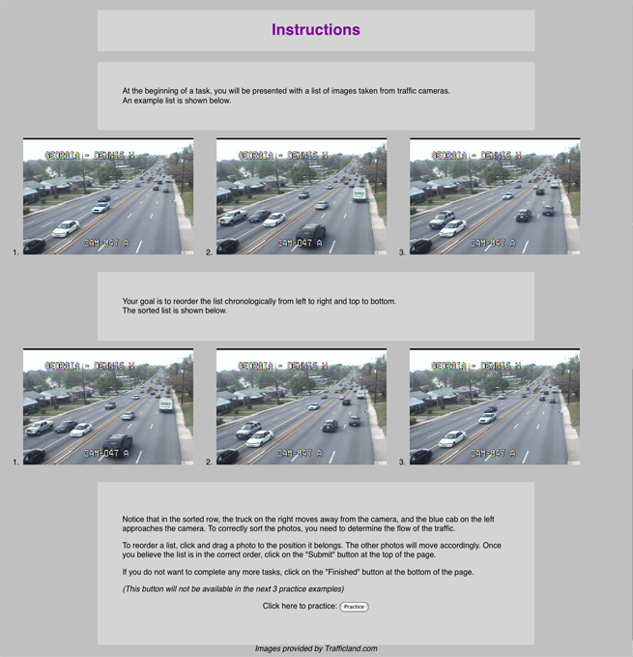
Study 1: Traffic Images
Manipulated
Task Value
  Amount earned per image set
    $0.01, $0.05, $0.10
    No additional pay for image sets
Difficulty
  Number of images per set
    2, 3, 4
Measured
Quantity
  Number of image sets submitted
Quality
  Proportion of image sets correctly sorted
  Rank correlation of image sets with correct order

Slide 27
How Much to Pay?
Pay rate can affect quantity of work
Pay rate does not have a big impact on quality
(MW ’09)

Slide 28
Intent to Treat
Keep track of attrition by condition
Example:
  H: Noisy sites decrease reading comprehension
  BUT find no difference between conditions
  Why? Most people in noisy condition dropped out, only people left were deaf!

Slide 29
Synchronous Experiments
Typical tasks on Mturk don’t depend on each other
  can be split up, done in parallel
How does one get many workers to do an experiment at the same time?
  Panel
  Waiting Room

Slide 30
Building the Panel
Do experiments requiring 4-8 fresh players
  Waiting time is not too high
  Less consequences if there is a bug
Ask if they would like to be notified of future studies
  85% opt in rate for SW ‘10
  78% opt in rate for MW ‘11

Slide 31
NotifyWorkers
Mturk API call that sends an e-mail to workers
Notify them a day early
Experiments work well 11am-5pm EST
If n subjects are needed, notify 3n
  Done experiments with 45 players simultaneously

Slide 32
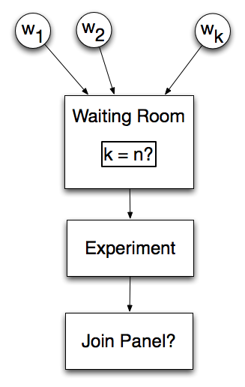
Waiting Room
…
Workers need to start a synchronous experiment at the same time
Workers show up at slightly different times
Have workers wait at a page until enough arrive
  Show how many they are waiting for
  After enough arrive tell the rest experiment is full
  Funnel extra players into another instance of the experiment

Slide 33
Attrition
In lab experiments subjects rarely walk out
On the web:
  Browsers/computers crash
  Internet connections go down
  Bosses walk in
Need a timeout and a default action
  Discard experiments with < 90% human actions
    SW ‘10 discarded 21 of 94 experiments with 20-24 people
  Discard experiment where one player acted < 50% of the time
    MW ‘11 discarded 43 of 232 experiments with 16 people

Slide 34
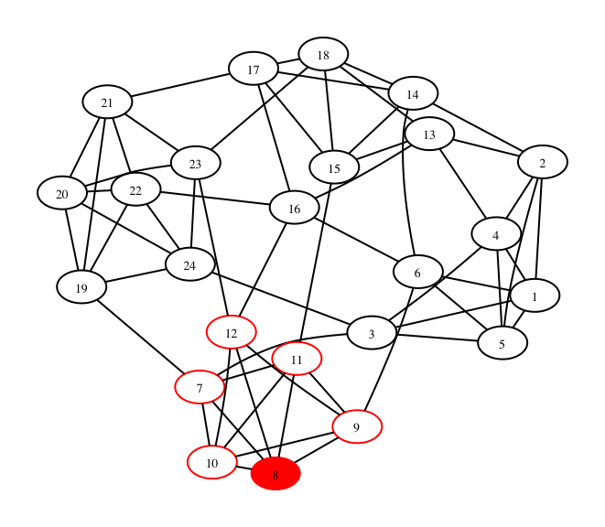
Social Dilemmas in Networks
A social dilemma occurs when the interest of the individual is at odds with the interest of the collective.
In social networking sites one’s contributions are only seen by friends.
  E.g. photos in Flickr, status updates in Facebook
  More contributions, more engaged group, better for everyone
  Why contribute when one can free ride?

Slide 35



Public Goods Games Over Networks
35
Players: nodes in a network G=(V,E), |V|=n
Actions:
  each player has endowment e
  player p contributes simultaneously with other players
Payoff:
where
Use regular graphs so the marginal rate of return is the same
Similar to Cassar ‘06
Notes:
Define public goods game when everyone is only player with their friends/neighbors.
explain why this is a dilemma:
- contributing one more unit returns a/n to each player, since a/n < 1, the dominant strategy is to contribute 0 - again, since contributing one more unit returns a/n to each player there are n player the overall increase to all players is a > 1
thus to maximize (social welfare) all players contribute e

Slide 36

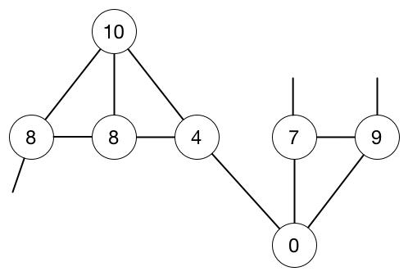

Public Goods Games Over Networks: Example
36
Piece of an example network with contributions and payoffs
Payoff function:

Slide 37

Experimental Parameters
Workers must pass a quiz
Pay $0.50 for passing the quiz plus 1/2 cent per point
10 rounds, 45 sec for first two, 30 sec for the rest
Parameters:
  Endowment for each round is 10 points
  Marginal rate of return is 0.4 (Fehr & Gachter ’00), regular graphs
  Payoff:
  n = 4, 6, 8, 24
  Some experiments all fresh players, others repeat players
37
Notes:
Give all parameters for the investment game

Slide 38
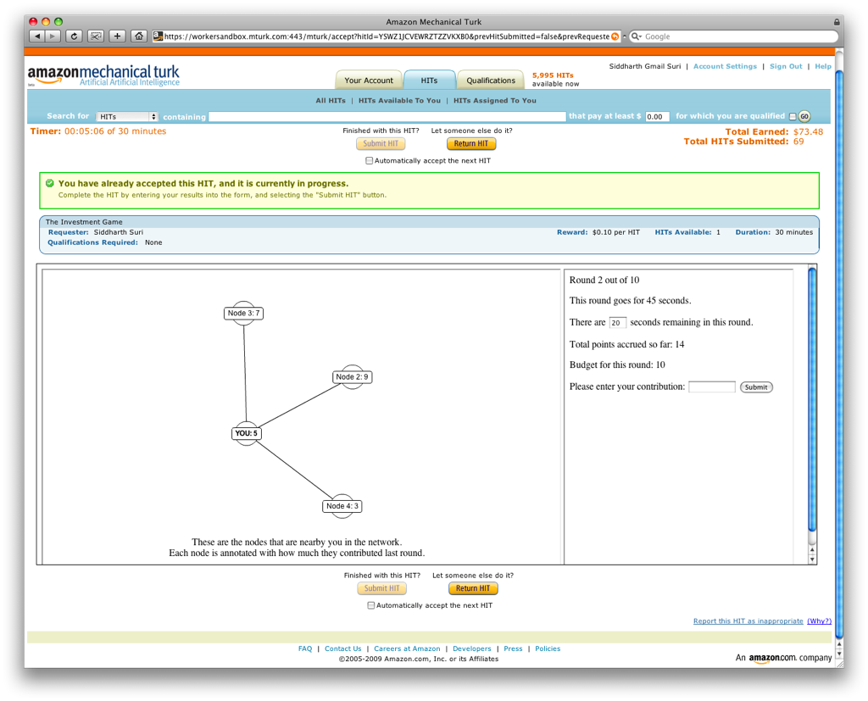
38
Notes:
Before I get to results any questions about format of experiments
skip?

Slide 39
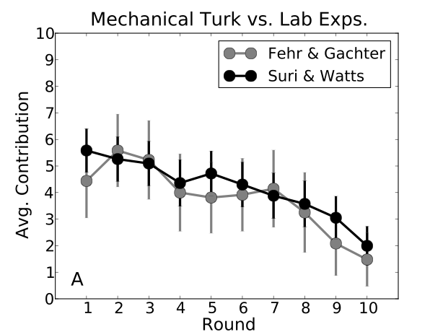
Mechanical Turk vs. Lab
39
Cliques of size 4
  allowed repeat players
  24 trials
MTurk experiments replicate tightly controlled lab experiments very well
  Fehr & Gachter, American Economic Review, 2000
    10 trials
Notes:
update the figure above

Slide 40
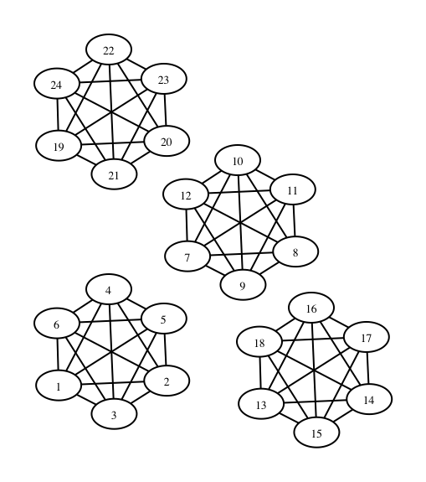
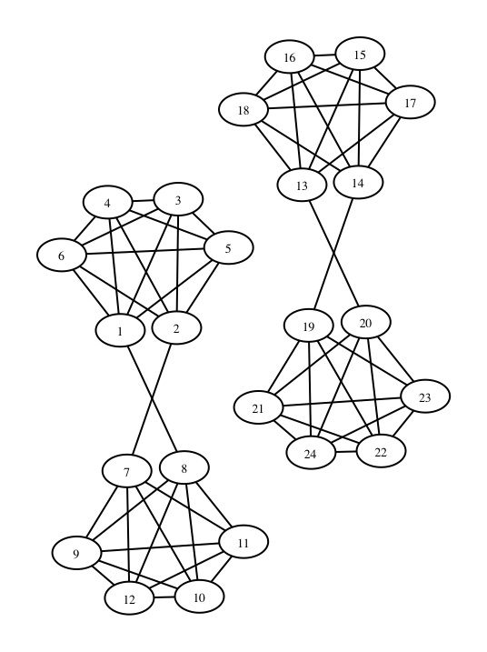
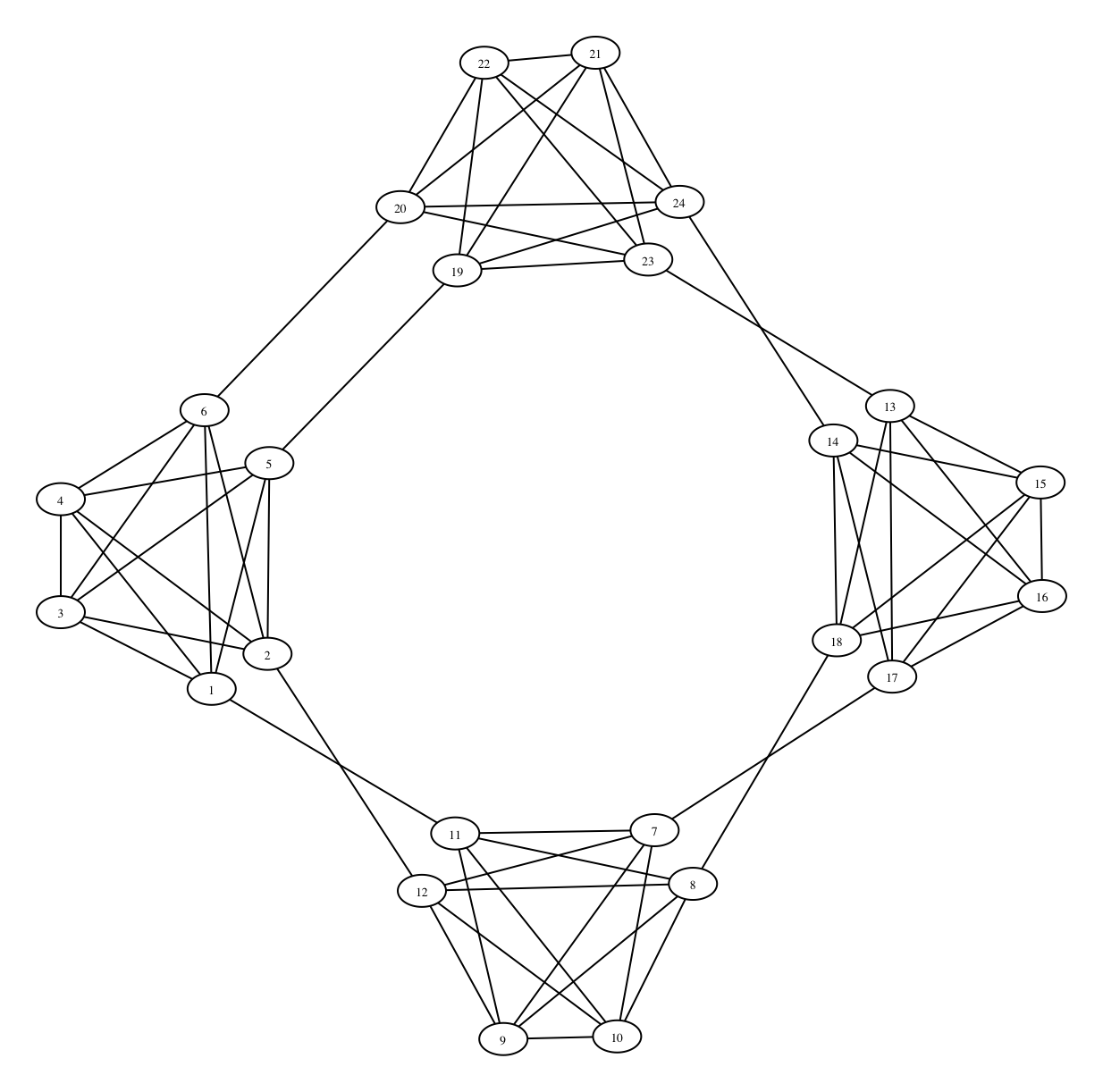
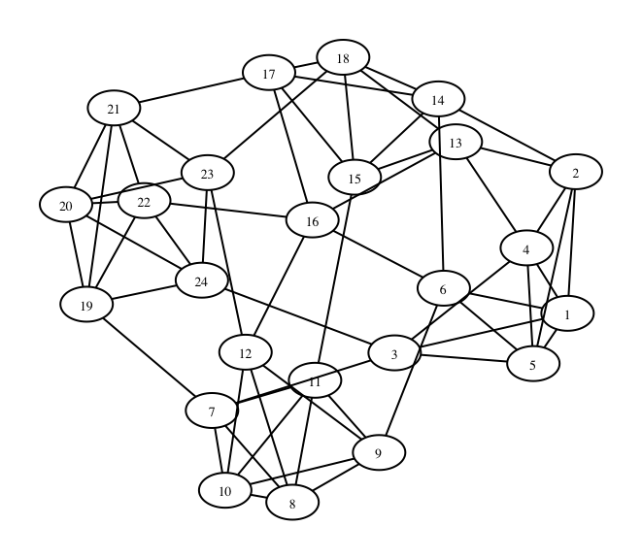
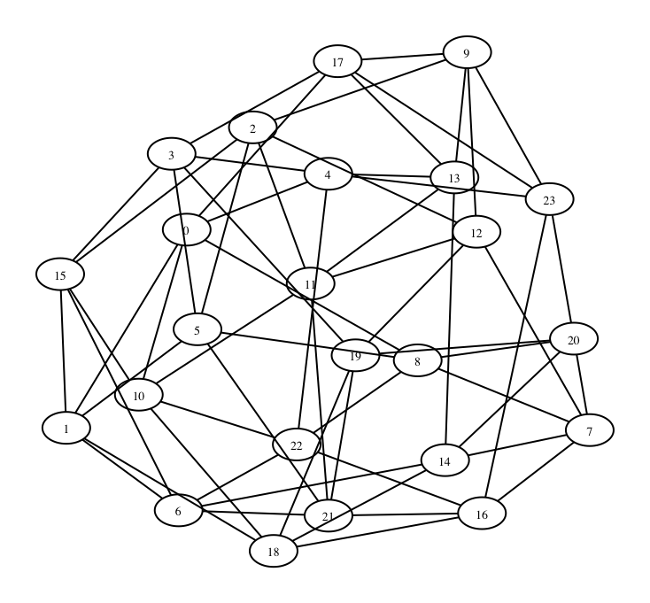
40
Cycle
Cliques
Paired
Cliques
Small
World
Random
Regular
Notes:
cite duncan

Slide 41

Statistical Properties of Networks
41
 | Clustering Coefficient | Average Path Length | Diameter | Connected Comps.
Cliques | 1.00 | 1 | ∞ | 4
Paired Cliques | 0.80 | 1.81 | ∞ | 2
Cycle | 0.60 | 2.54 | 5 | 1
Small World | 0.41 | 2.23 | 4 | 1
Random Reg. | 0.09 | 2.01 | 3 | 1
All Networks
24 nodes
60 edges
regular
degree 5
Notes:
C = \frac{1}{n} \sum_{v \in V} \frac{|\Delta \mbox{'s on v}|}{\binom{\deg(v)}{2}}
maybe only talk about clustering coefficient?
maybe cut the other columns

Slide 42
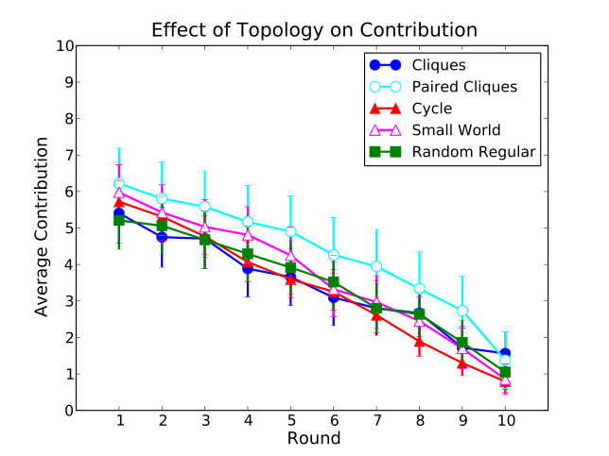
Effects of Topology on Contribution
42
Topology has little to no effect on contribution
  especially if you unify starting points
  23 trials, n=24
In contrast with coordination games over networks (Kearns et al ‘06, ’09)
Notes:
As you can see contribution levels go down, what can we do to increase contribution levels

Slide 43
Enhancing Contribution
Surveys: Ledyard ‘95, Camerer & Fehr ‘06
Punishment: pay to deduct point from others
  Ostrom et al ‘92, Fehr & Gachter ’00 ’02,...
  Results in a loss of efficiency but enhances cooperation
Rewards: transfer points to others
  with reciprocity enhances cooperation: Rand et al ’09
  without reciprocity doesn’t enhance cooperation: Sefton et al ’07,...
Can enhance cooperation if you change the game
  artificial seed players that always contribute 10 or 0
43
Notes:
Key point, if you change the game, can get cooperation, we don’t change the game
double check Rand and Sefton bullets

Slide 44
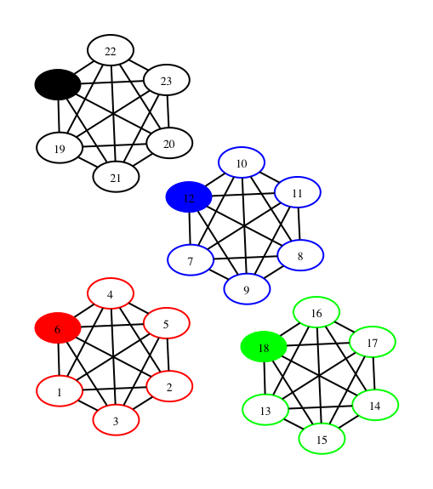
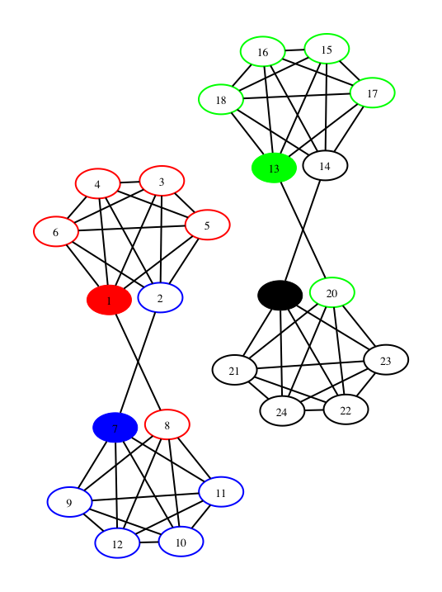
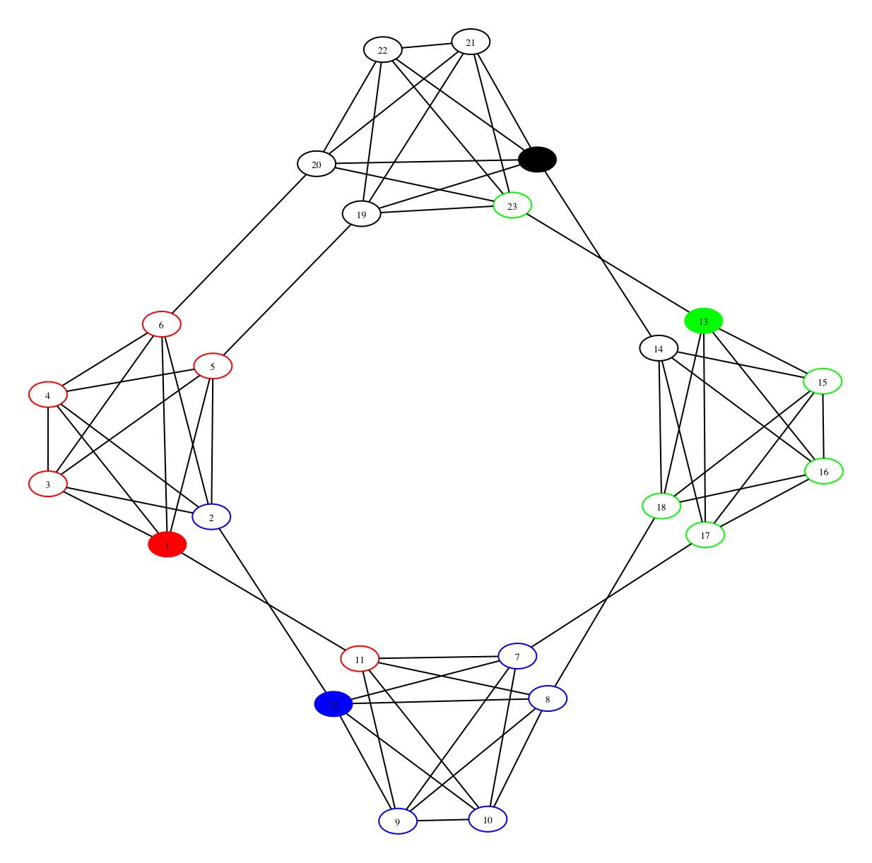
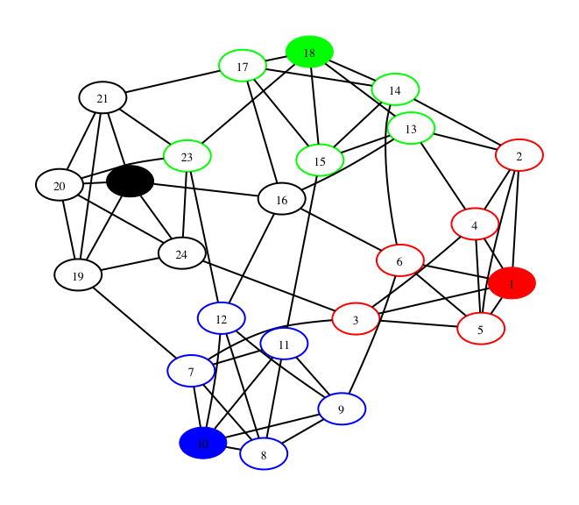
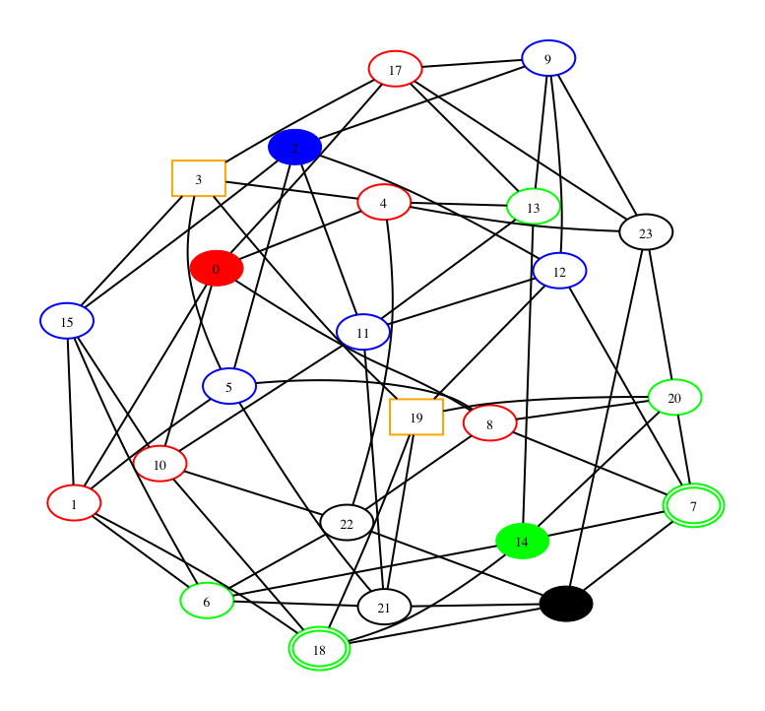
44
Cycle
Cliques
Paired
Cliques
Small
World
Random
Regular
Notes:
Ask students to guess whether they think dummies matter

Slide 45
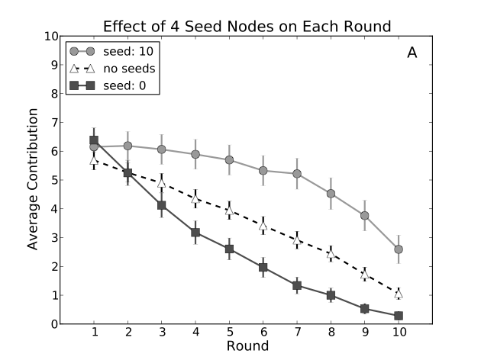
Effect of Seed Nodes
45
10-seeds: 13 trials 0-seeds: 17 trials
Only human contributions are included in averages
People are conditional cooperators
  Fischbacher et al. ‘01
Notes:
10-dummies make a concave curve
0-dummies make a convex curve

Slide 46
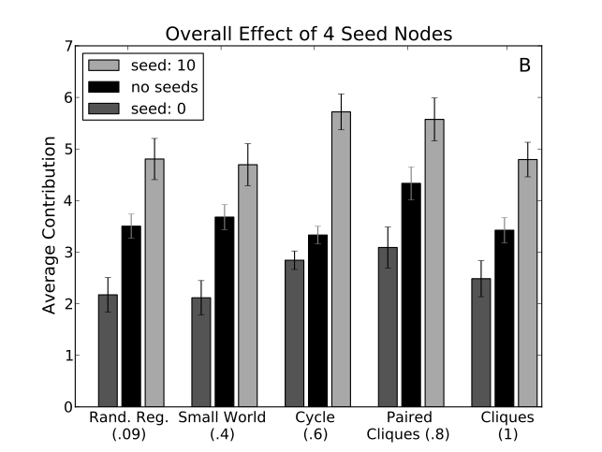
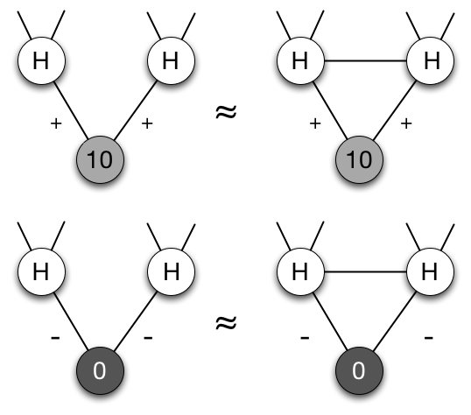
Effect of Seeds on Overall Contribution
46
Effect of seed players is not consistently bigger in networks with higher clustering.
Notes:
Could also put in a table that shows how the average contributions levels vary with clustering coefficient
Could put a slide in after this showing that the the gap between black and blue in 4_k_6 rand and random regular fit the theory from my EC ’06 paper
change color of error bars use most recent plot (also for 4_k_6_cycle)

Slide 47
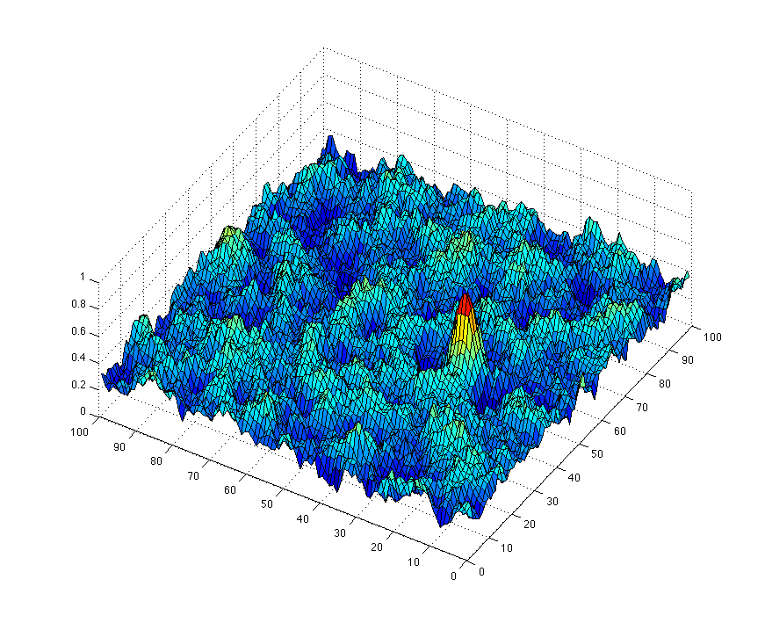
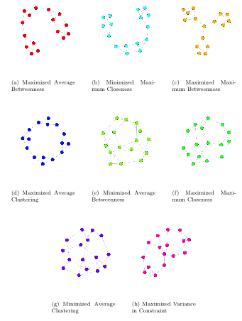
WildCat Wells
16 players in 8 regular graphs
Rugged payoff function with single global maximum

Slide 48
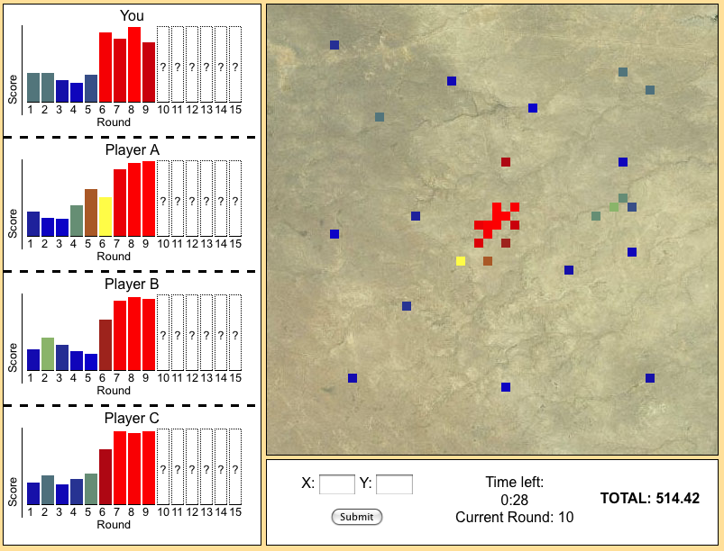
WildCat Wells
Same amount of information, so network is unknown to players
Known maximum
15 rounds to explore
No information when rounds skipped

Slide 49
WildCat Wells
Waiting room: shows how many players waiting, allows players to come and go, starts game when 16 players have joined
Panel: Notify players by email & Turker Nation ahead of time.

Slide 50
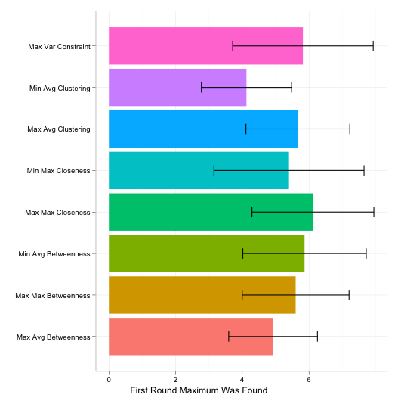
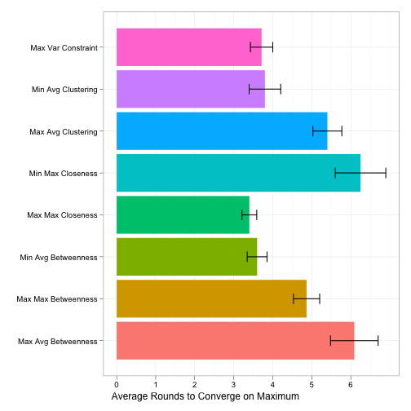
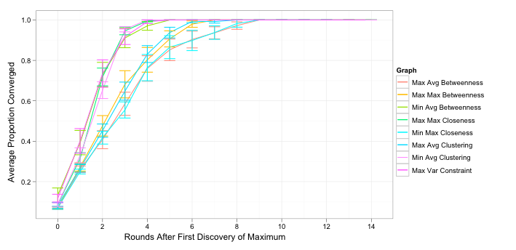
Significant differences in how quickly players converged
No differences in how quickly the maximum was found (avg. = 5.43 rounds)

Slide 51
Quality Assurance
Majority vote
Mutual Information
Machine learning of responses
Verifiable answers
Time to completion
Additional HITs to validate responses
Monitor discussion on forums. MW ’11: Players followed guidelines about what not to talk about.

Slide 52
Use Cases
But ANY online study can be done on Turk (it can be used as recruitment tool)
  E.g. using the survey monkey technique
Reputation matters, so abusive studies will fail quickly
Iterative research process:
  Hypothesis testing
  Evaluation of results
  New hypothesis tests

Slide 53
Open questions
What are the conditions in which workers perform differently than the laboratory setting?
How often does one person violate Amazon’s terms of service by controlling more than one worker account?
Are workers more or less honest then students in the laboratory?
Although the demographics of the workers on Mechanical Turk is clearly not a sample of either the U.S. or world populations, could one devise a statistical weighting scheme to achieve this?
Mechanical Turk provides a ripe opportunity for cross cultural studies.
Since workers are tied to a unique identifier (their Worker ID) one could conduct long term, longitudinal studies about how their behavior changes over time.

Slide 54
Thank you!
Conducting Behavioral Research on Amazon's Mechanical Turk
  Winter Mason
  Siddharth Suri
  Yahoo! Research, New York
  http://papers.ssrn.com/sol3/papers.cfm?abstract_id=1691163

